Slide 1
Smart Network Switch
Group 9
Mahmoud Kharsa
Mark Bugaisen
David Nguyen

Slide 2
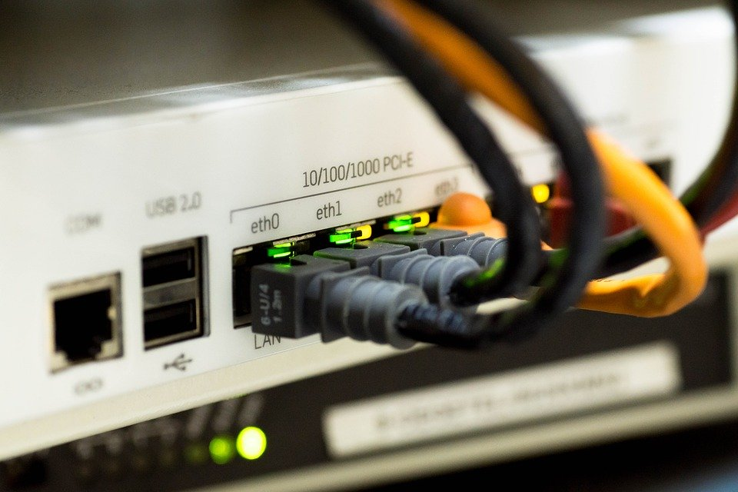
Project Overview
Forward network traffic to the right target
Done by building an address-port table

Slide 3
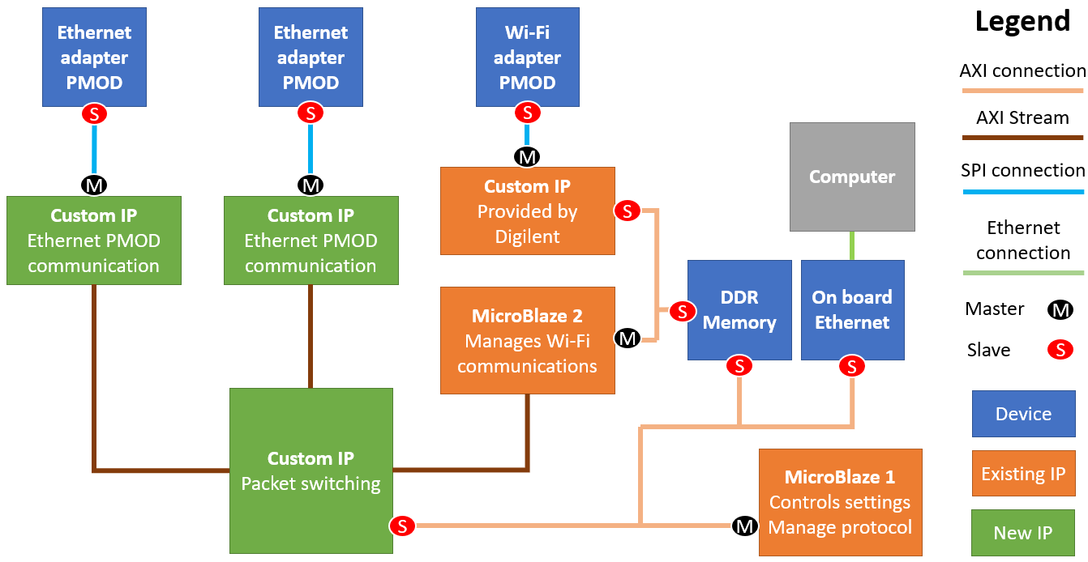
System Block Diagram
Notes:
Go through the modules briefly.
Perhaps also comment that we didn’t make any major changes to the diagram. (I saw that a bunch of groups did make changes)

Slide 4
Requirements
FPGA routes packets to the correct destination device (in hardware)
Support two devices connected across Ethernet
Support one device connected across Wi-Fi
Support IPv4
Remotely configurable
Has monitoring capabilities from a PC connected across Ethernet
Minimum Throughput: 1Mb/s
Maximum Latency: 100 ms
~
✓
✕
✓
✕
✕
✓
✓

Slide 5
Initial Project Timeline (Mid-Project Demo)
Ethernet PMOD
Look at Ethernet PMOD specs
Implement the SPI interface
Initialize the PMOD correctly
Showcase:
N/A (this will be done later on)
Wi-Fi PMOD
Look at Wifi PMOD specs
Initialize and set as access point correctly
Establish communication through sending commands
Showcase:
Communication with a remote device
Packet Switching IP
Create design plan
Implement in Verilog
Develop testbench
Verify and debug functionality using simulation
Showcase:
Switching of packets
Status:
Completed ahead of Schedule
Status:
Not Completed / behind schedule
Status:
Completed on schedule

Slide 6
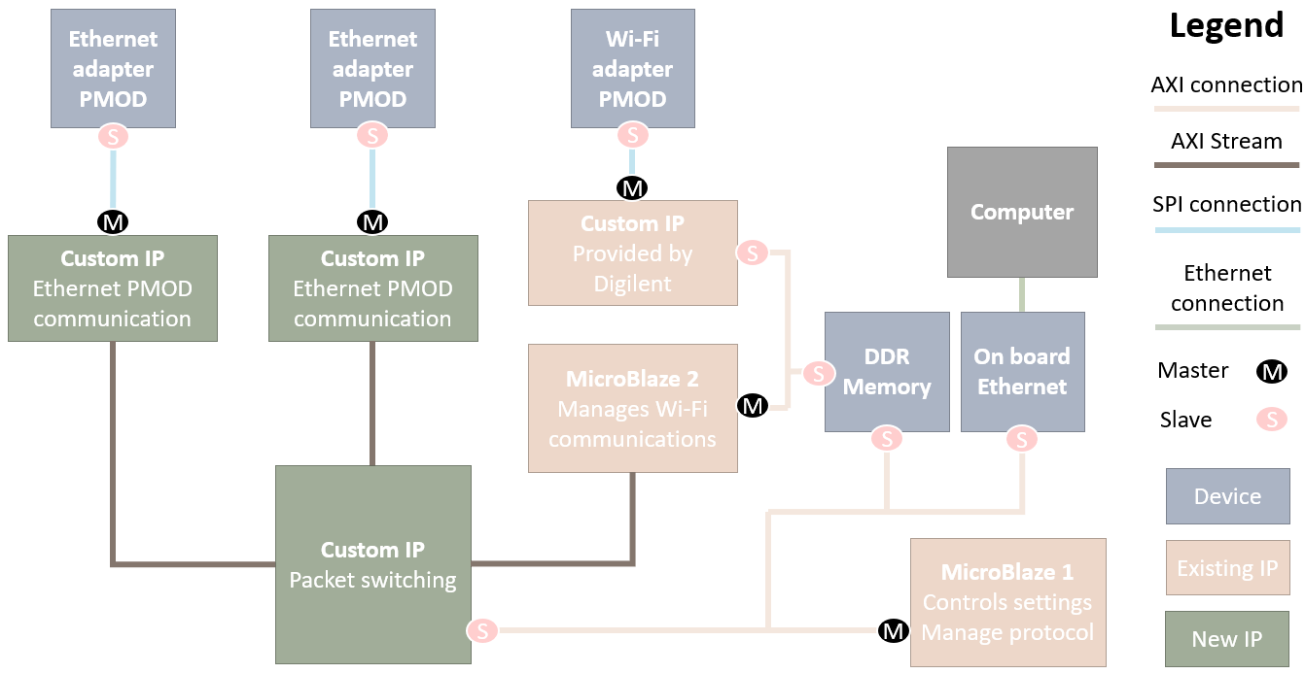
Implementation Progress
This was done during the Warmup Project
Notes:
Ethernet PMOD communication done and tested
Packet Switching Custom IP hardware implementation finished and verified via simulation
Implementation of Wi-fi module done, but currently debugging issues (to be discussed later in the presentation)

Slide 7
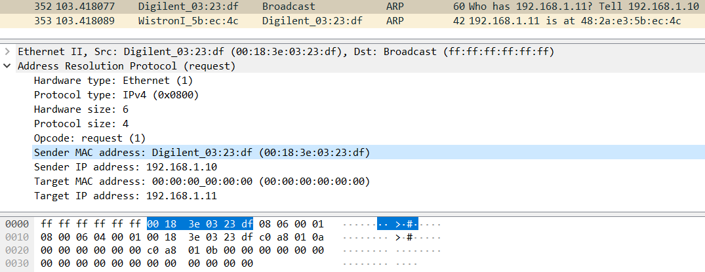
Demo: Ethernet PMOD Communication (Transmit)

Slide 8
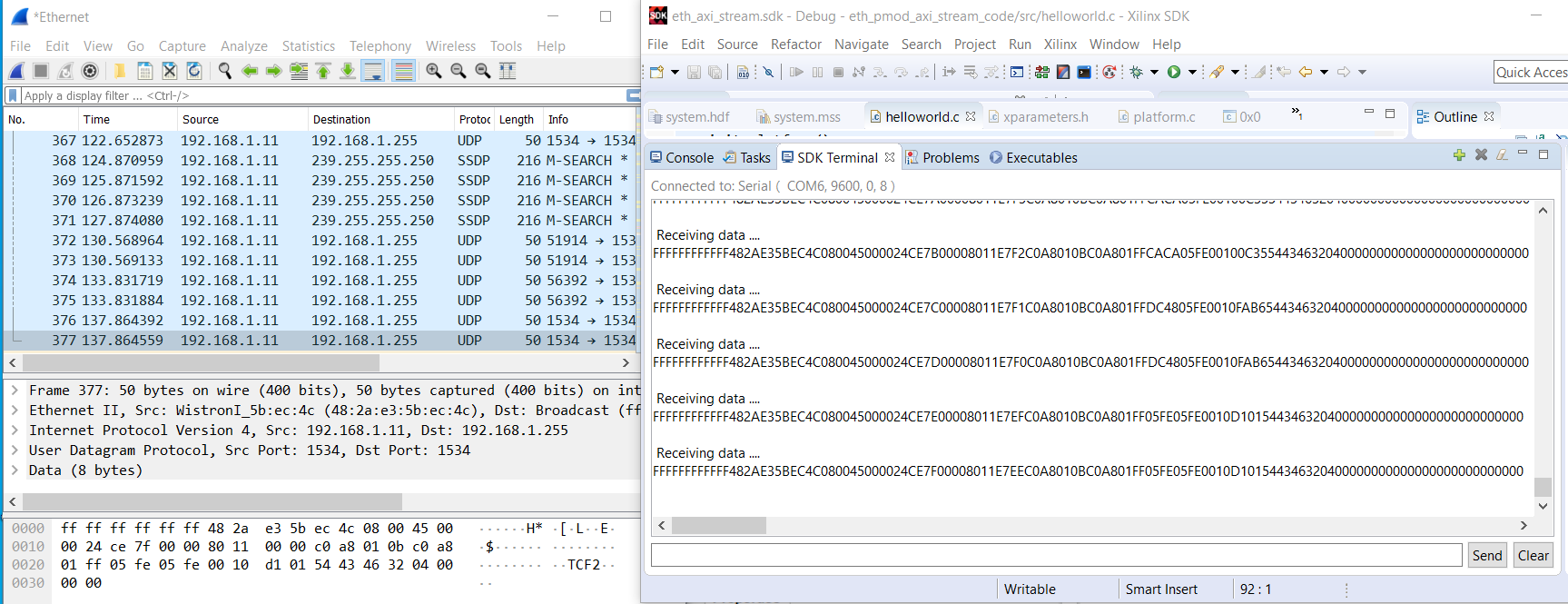
Demo: Ethernet PMOD Communication (Receive)

Slide 9
Challenges Encountered
Wi-Fi PMOD communication
ESP32 PMOD was not readily available, had to wait a full week to order it
Debugging issues where the PMOD is not properly responding to sent commands
AXI-Stream FIFO (for demo only)
If Transmit size is not the same as data pushed in, no response

Slide 10
Next Steps
Notes:
Ethernet PMOD communication done and tested
Packet Switching Custom IP hardware implementation finished and verified via simulation
Implementation of Wi-fi module done, but currently debugging issues (to be discussed later in the presentation)

Slide 11
Updated Timeline
Milestone 5
Integration of the Packet Switching IP and Ethernet PMOD modules
Debug Wi-Fi PMOD communication
Milestone 6
Add Microblaze configuration of the Packet Switching IP (turn off ports, track dropped packets, etc.)
Integration of the Packet Switching IP and Wi-Fi PMOD module
Final Demo
One week of ‘leeway’ time
Resolve/Debug any issues or setbacks that occur in previous milestones

Slide 12
Potential Risks
Might not get the ESP32 Wi-Fi PMOD working
Can’t receive much help, not many other groups use this PMOD
Likely not enough time to experiment with backup PMODs
Last Resort: Substitute with 3rd Ethernet PMOD
Might not successfully integrate the Packet Switch IP + PMODs
Main portion of project, hence it’s much more severe
Mitigation: One week of ‘leeway’ time in the timeline
Last Resort: Do Packet Switching in software (if no convergence by Milestone 6)

Slide 13
ANY QUESTIONS?

